Slide 1

COMPUTING DEVICES GROUP 14
1. Introduction
2. Types of Computing Devices
3. Core Components
4. How Computing Devices Work
5. Applications in Daily Life
6 . Emerging Trends
7. Challenges & Considerations
This presentation introduces computing devices, their types, uses in daily life, and future trends.
8. Conclusion & Q&A

Slide 2
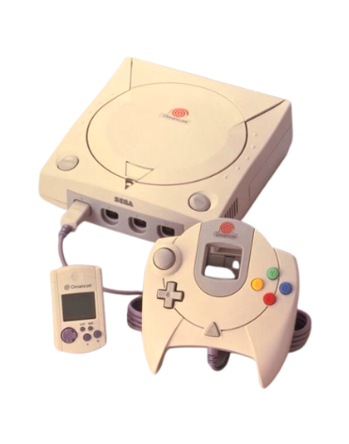
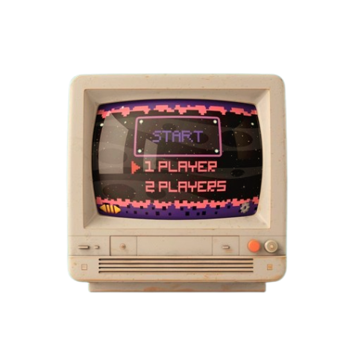
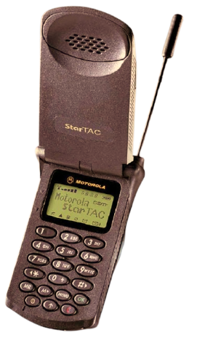
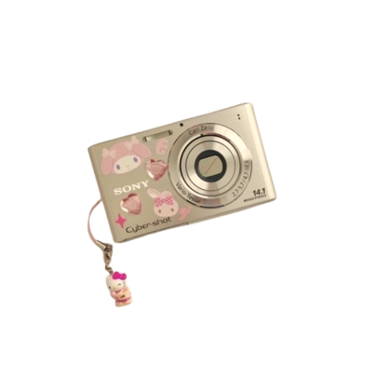
1. Introduction
2. Types of Computing Devices
3. Core Components
4. How Computing Devices Work
5. Applications in Daily Life
6 . Emerging Trends
7. Challenges & Considerations
8. Conclusion & Q&A

Slide 3
1. Introduction
Definition
Purpose
Importance in modern life
2. Types of Computing Devices
3. Core Components
4. How Computing Devices Work
5. Applications in Daily Life
6 . Emerging Trends
7. Challenges & Considerations
8. Conclusion & Q&A

Slide 4
2. Types of Computing Devices
Personal Computers (PCs)
Mobile Devices
Embedded Systems
Servers
IoT & Wearables
2. Types of Computing Devices
3. Core Components
4. How Computing Devices Work
5. Applications in Daily Life
6 . Emerging Trends
7. Challenges & Considerations
8. Conclusion & Q&A

Slide 5
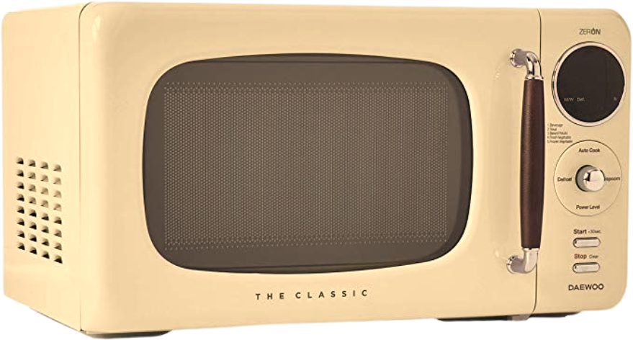
2. Types of Computing Devices
Personal Computers (PCs)
Mobile Devices
Embedded Systems
Servers
IoT & Wearables
2. Types of Computing Devices
3. Core Components
4. How Computing Devices Work
5. Applications in Daily Life
6 . Emerging Trends
7. Challenges & Considerations
8. Conclusion & Q&A

Slide 6
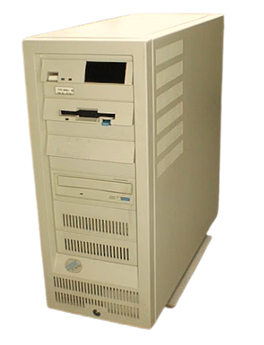
2. Types of Computing Devices
Personal Computers (PCs)
Mobile Devices
Embedded Systems
Servers
IoT & Wearables
2. Types of Computing Devices
3. Core Components
4. How Computing Devices Work
5. Applications in Daily Life
6 . Emerging Trends
7. Challenges & Considerations
8. Conclusion & Q&A

Slide 7
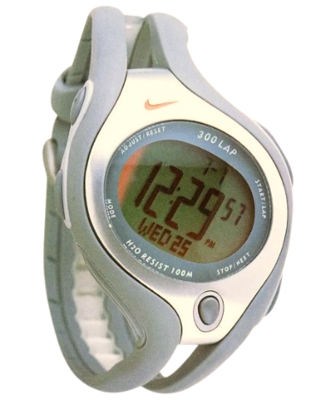
2. Types of Computing Devices
Personal Computers (PCs)
Mobile Devices
Embedded Systems
Servers
IoT & Wearables
2. Types of Computing Devices
3. Core Components
4. How Computing Devices Work
5. Applications in Daily Life
6 . Emerging Trends
7. Challenges & Considerations
8. Conclusion & Q&A

Slide 8
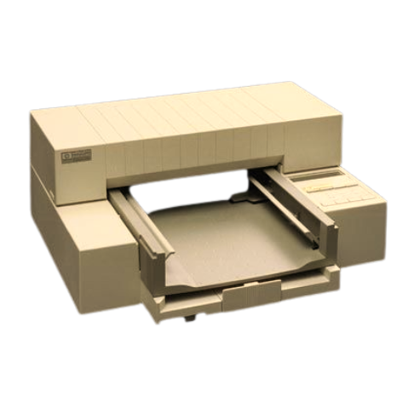
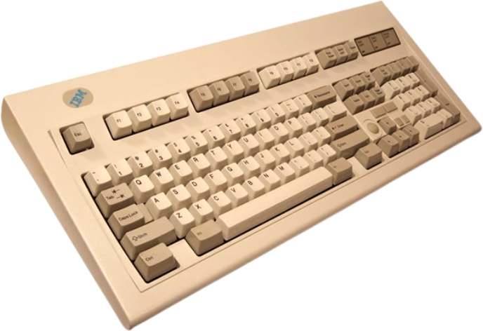
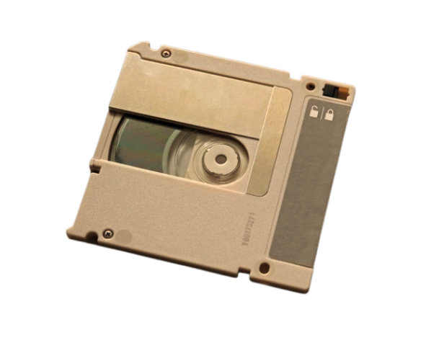
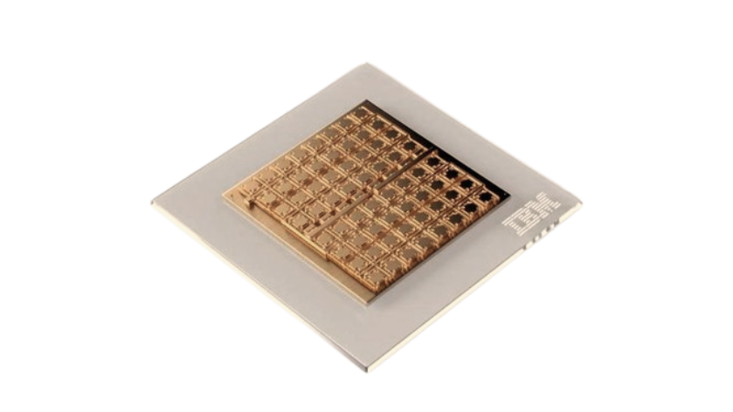
2. Types of Computing Devices
Personal Computers (PCs)
Mobile Devices
Embedded Systems
Servers
IoT & Wearables
2. Types of Computing Devices
3. Core Components
4. How Computing Devices Work
5. Applications in Daily Life
6 . Emerging Trends
7. Challenges & Considerations
8. Conclusion & Q&A

Slide 9

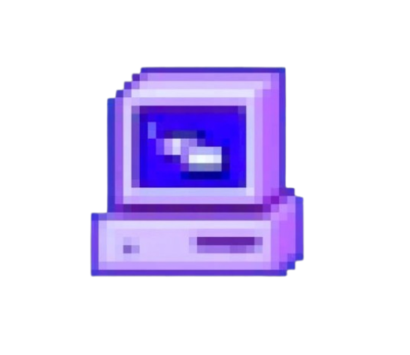

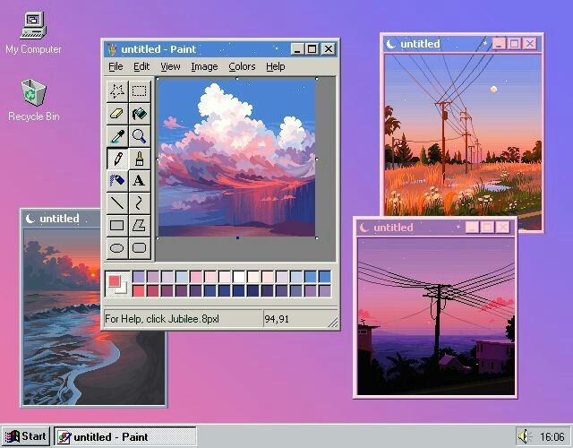
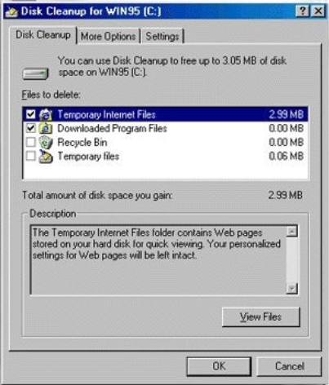

3. Core Components
1. Hardware
Input: Keyboard, mouse, mic,..
Output: Monitor, printer,..
Processing: CPU/GPU,..
Storage: RAM, SSD/HDD,..
2. Software
3. Connectivity
2. Types of Computing Devices
3. Core Components
4. How Computing Devices Work
5. Applications in Daily Life
6 . Emerging Trends
7. Challenges & Considerations
8. Conclusion & Q&A

Slide 10



3. Core Components
1. Hardware
2. Software
System: Windows, iOS,..
Apps: Zoom, Office, Facebook,..
Utilities: Antivirus, cleanup tools,..
3. Connectivity

Slide 11
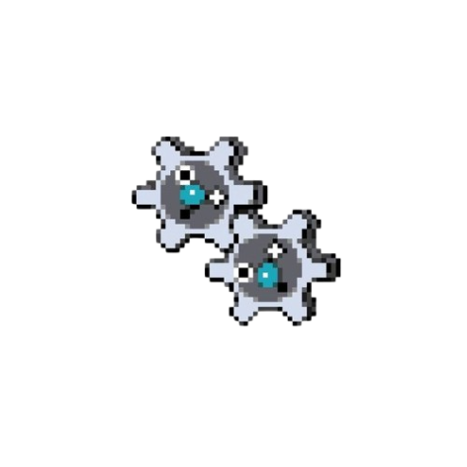
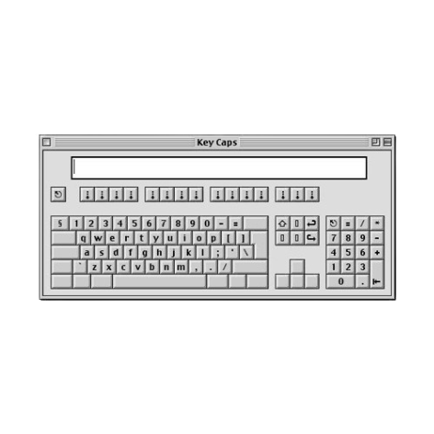
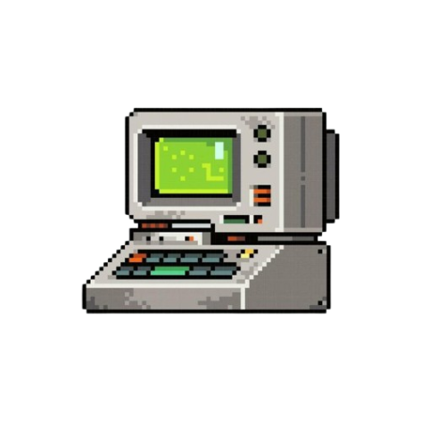





3. Core Components
1. Hardware
2. Software
3. Connectivity
Wi-Fi, Bluetooth, USB, 5G,..

Slide 12
4. How Devices Work
1. Workflow
Input → Processing → Storage → Output
2. Real-Time Example

Slide 13
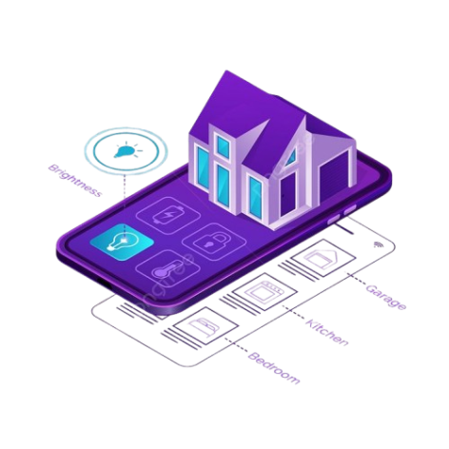

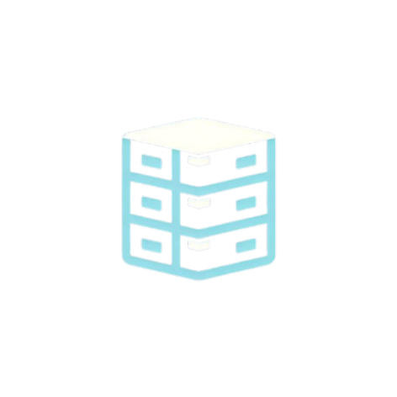



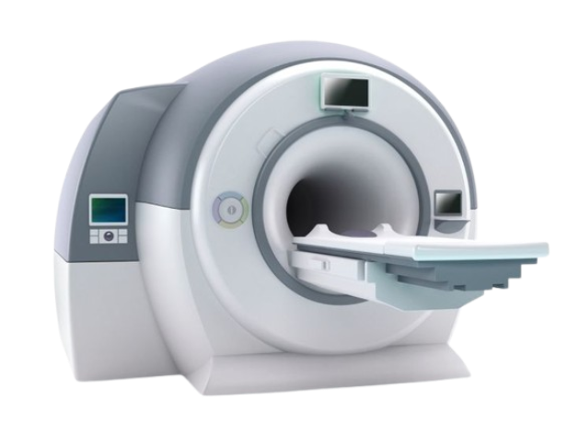
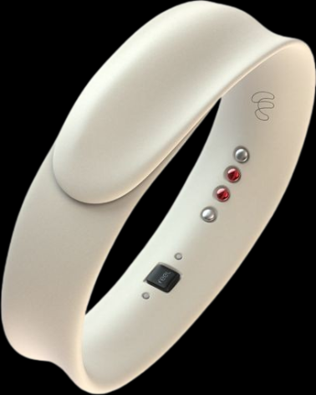



4. How Devices Work
Family Use
Smart homes, security, reminders,..
Education
Business
E-learning, digital notes,..
Cloud work, inventory systems,..
Healthcare
Entertainment
MRI, telemedicine, wearables,…
Streaming, VR, gaming,..
1. Workflow
Input → Processing → Storage → Output
2. Real-Time Example
Sending email = Typing → Encryption → Cloud → Delivery

Slide 14



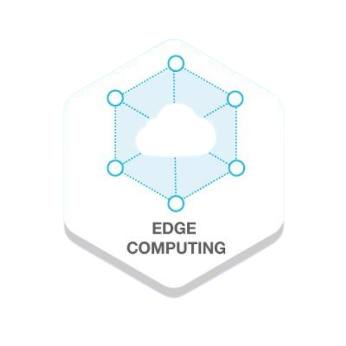

5. Applications in Daily Life
AI: Siri, Alexa
Quantum Computing
Edge Computing
Sustainability: Energy-saving tech, recycling
Education
Business
E-learning, digital notes,..
Cloud work, inventory systems,..
Family Use
Smart homes, security, reminders,..
Healthcare
Entertainment
MRI, telemedicine, wearables,…
Streaming, VR, gaming,..

Slide 15
6. Emerging Trends
AI: Siri, Alexa
Quantum Computing
Edge Computing
Sustainability: Energy-saving tech, recycling
Education
Business
E-learning, digital notes,..
Cloud work, inventory systems,..
Healthcare
Entertainment
MRI, telemedicine, wearables,…
Family Use
Streaming, VR, gaming,..
Smart homes, security, reminders,..

Slide 16
7 Challenges & Considerations

Slide 17
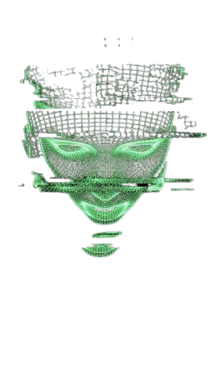
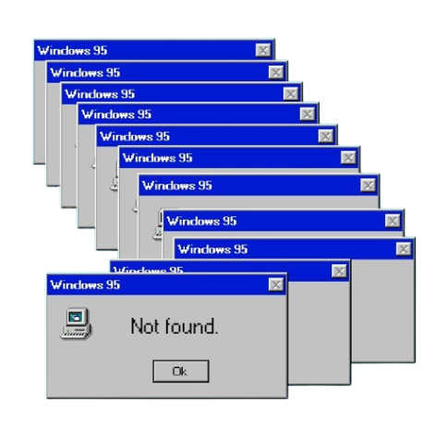
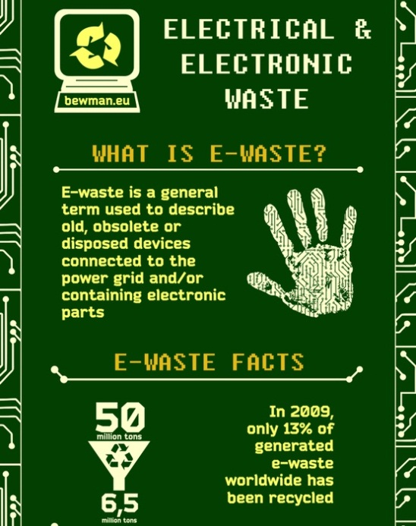
Security
Ethics
Environment
Hacking, breaches
Privacy, AI bias
E-waste, power use

Slide 18
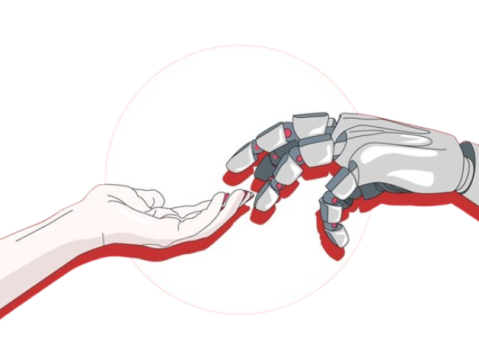
8 Conclusion & Q&A
Computing devices shape our digital world
Constantly evolving to meet human needs
Quote: “Understanding these tools empowers us to use them responsibly and innovatively.”
Q&A: Invite questions/discussion

Slide 19
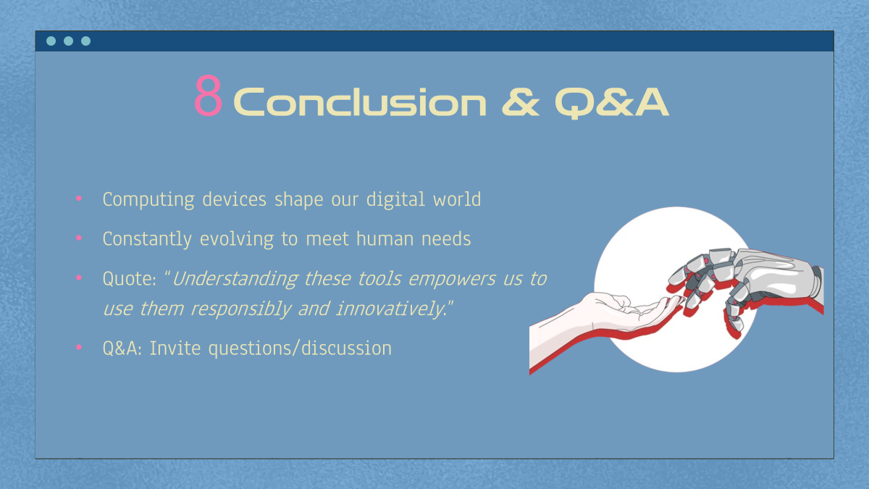
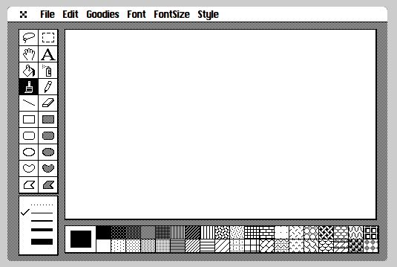

Slide 20
Thank you for watching and listening

